Slide 1
Scripted Model Development
Jake Knight
Hydrologist
USGS Arizona Water Science Center

Slide 2
Introductions
Who am I?
Who are you?
Agenda
2 – 3 short presentations on how/why to use Python code for model development
Live demonstrations between each presentation
Instructions for downloading the software and code presented today
Tips for getting started, links to helpful resources
Anything else you want to discuss

Slide 3

All about me (20yrs ago)
Miami Undergrad 2001-2005
Political science
Pre-med
Electives!
Geology seminar, German 101, Jazz orchestra
Somehow led to:
MUDEC study abroad semester in Luxemburg
Europe and the Environment, taught by….
Which led to:
HYDROLOGY!

Slide 4

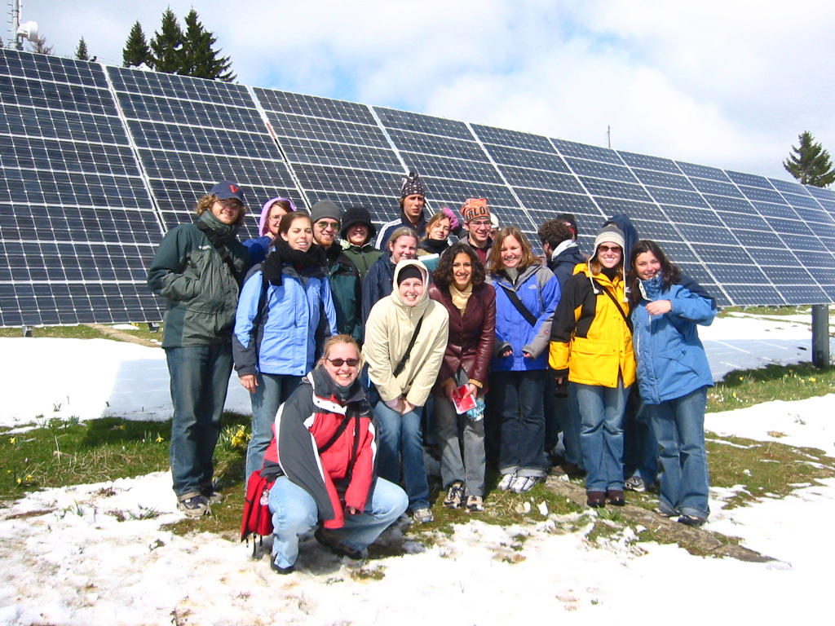

All about me (20yrs ago)
Environmental Science! HYDROLOGY!

Slide 5




Slide 6

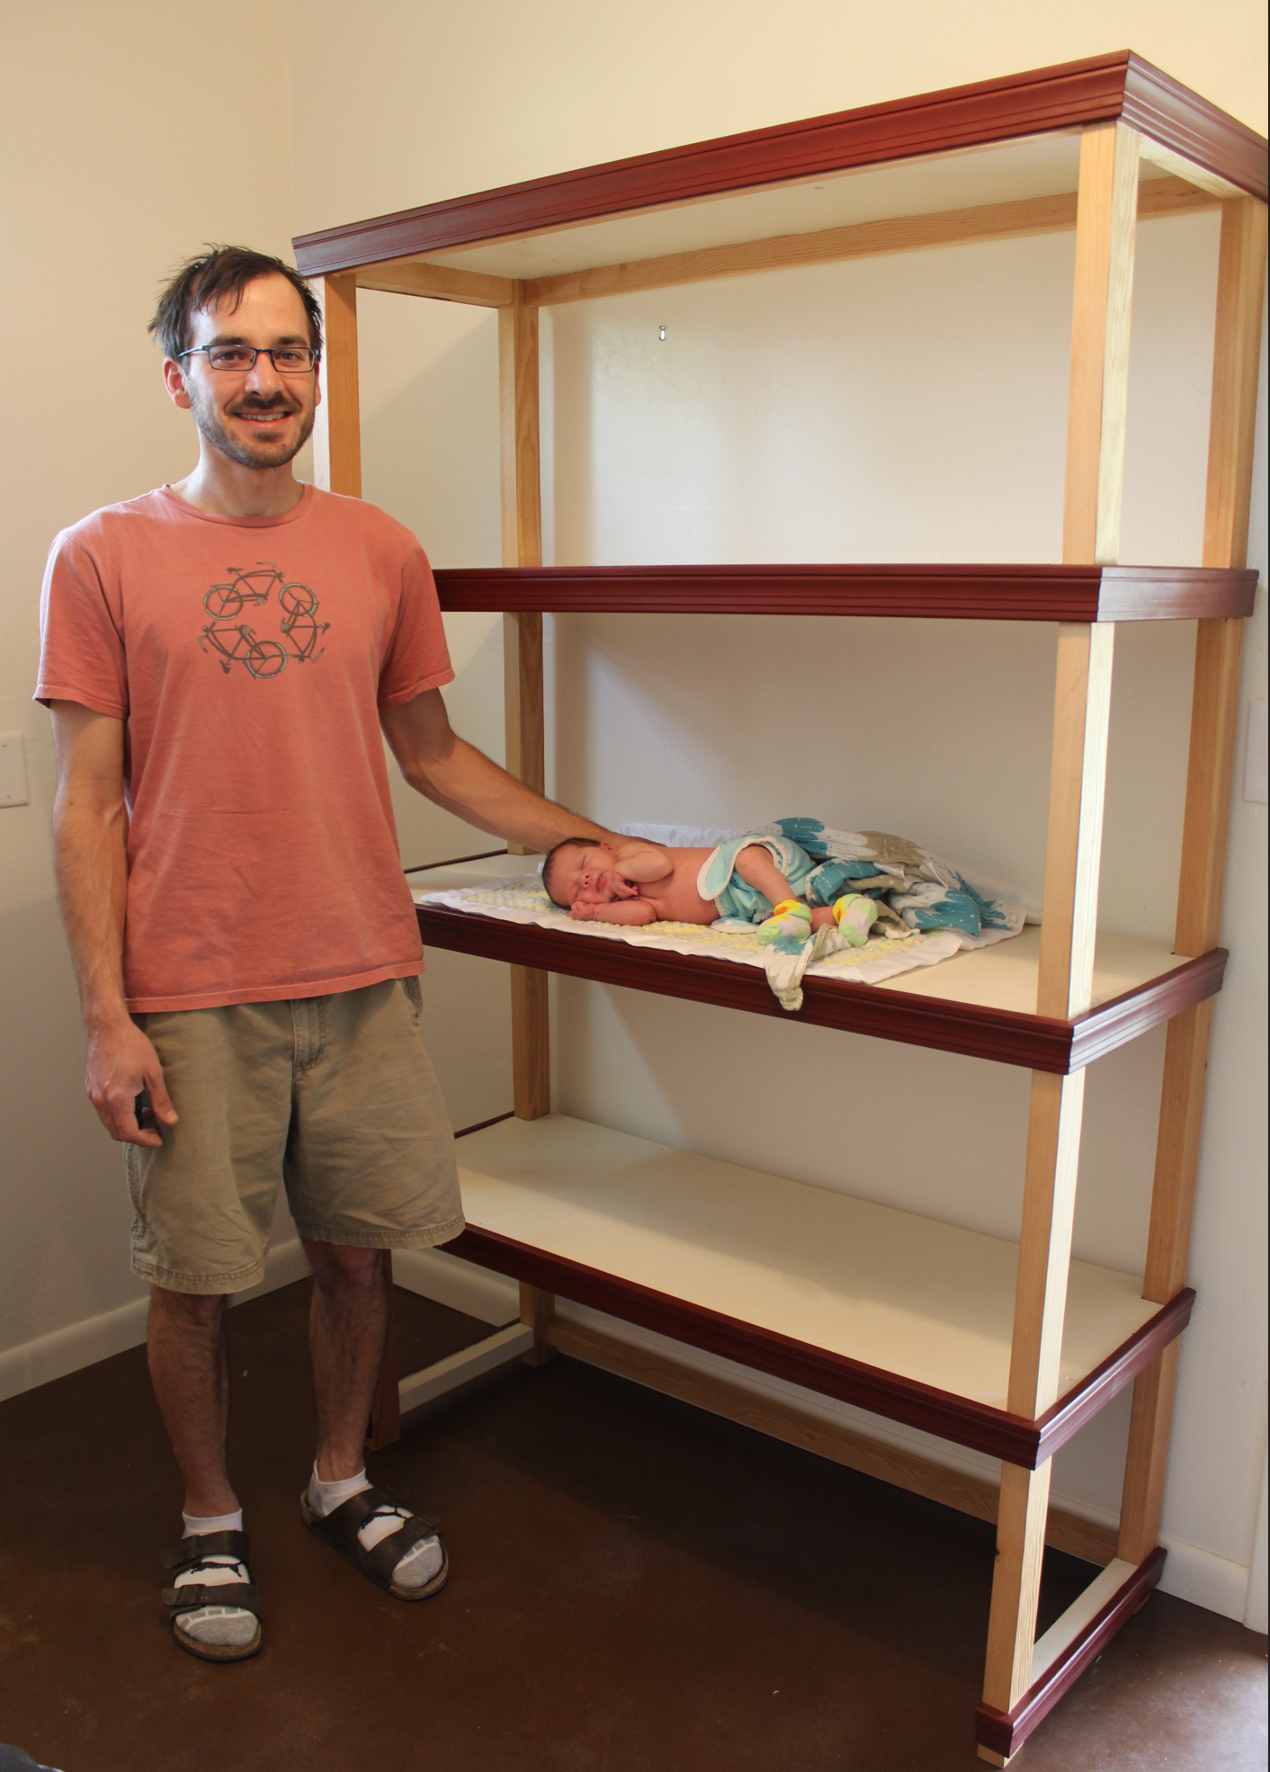


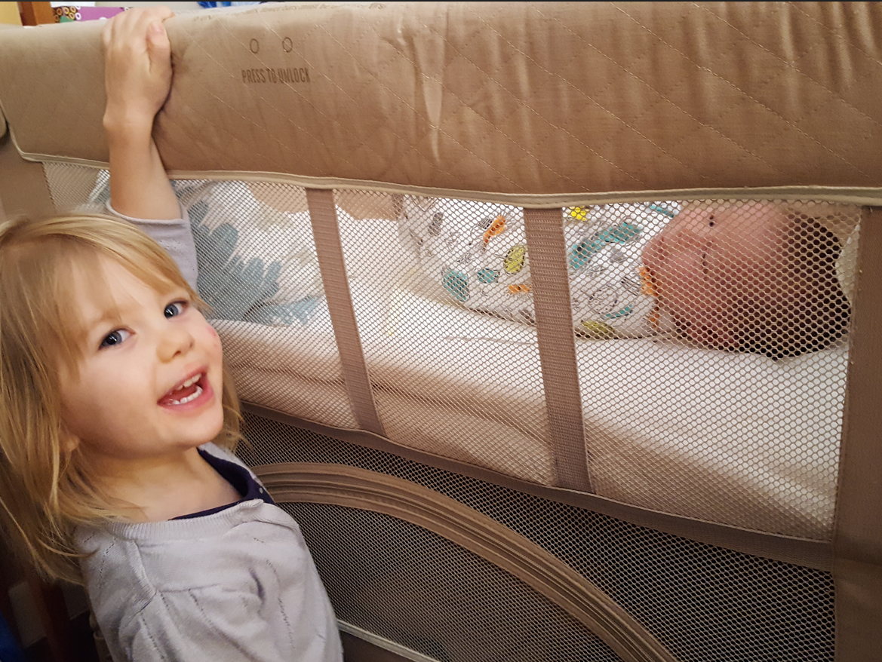
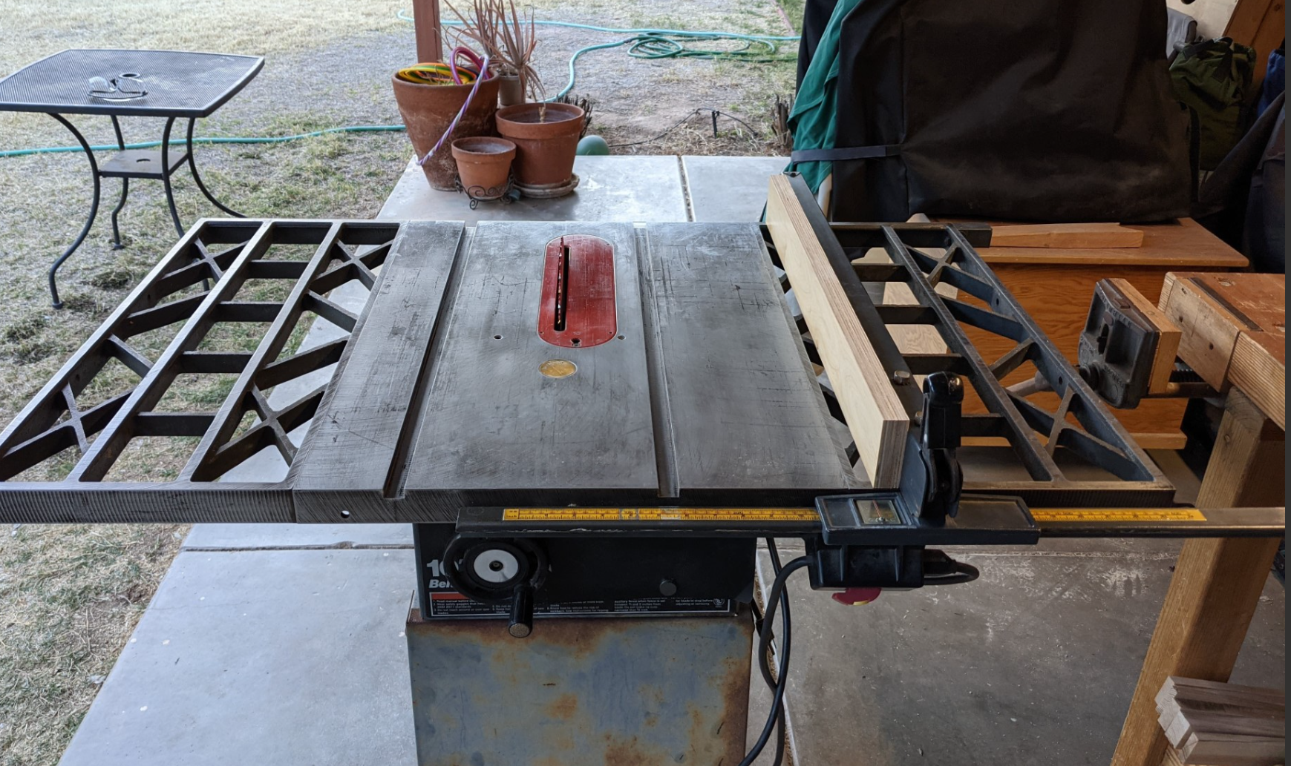

Slide 7
All about YOU
What’s your major, minor, thesis topic?
Any interest in Environmental System modeling?
Any experience writing/using code?
Care to share something about yourself?

Slide 8
Agenda - Water we doing here
Interactive(ish) presentations that you can download and use later on
Ideally, we would install the software on your machines and run the code together, but too many IT pitfalls for 2 hr remote session
Scripts are recipes, start simple and build from there
Introduction to scripted-development model workflows
Python + FloPy for MODFLOW models
Load, build, run, investigate, plot
Python + PyEmu for PEST++ deployments
Define parameters and observations, evaluate and upgrade ensembles of models
Case study on opportunities and benefits of a scripted approach
Anything else you want to discuss!
Career advice? Let me tell you about USGS!

Slide 9
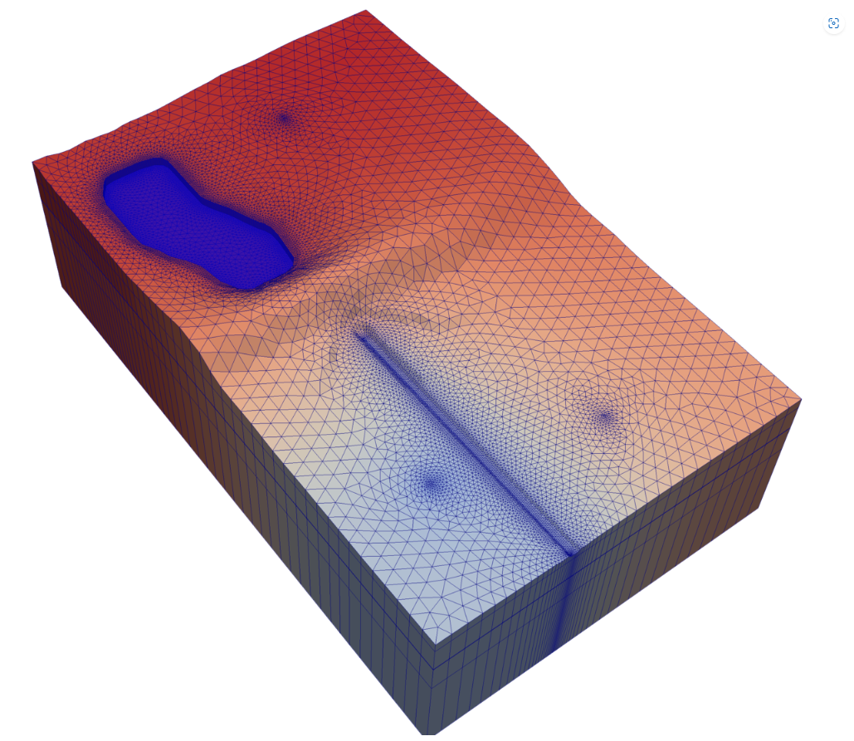


Part 1: MODFLOW + Python = FLoPy

Slide 10
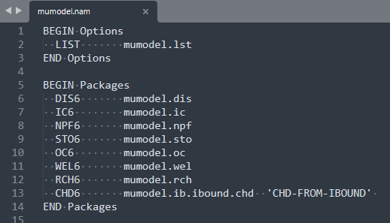
MODFLOW + Python = FLoPy model development
MODFLOW input is a collection of simple text files
NAM file specifies the packages to be used and points to the (other) text files containing the input for those packages

Slide 11
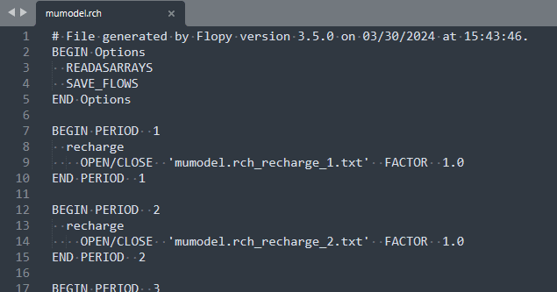
MODFLOW + Python = FLoPy model development
MODFLOW input is a collection of simple text files
Each package is defined by options and properties in its own specific text file

Slide 12
MODFLOW + Python = FLoPy model development
MODFLOW input is a collection of simple text files
The properties for a given package can be defined as values within the package file, or in separate external files that are pointed to by the package file

Slide 13
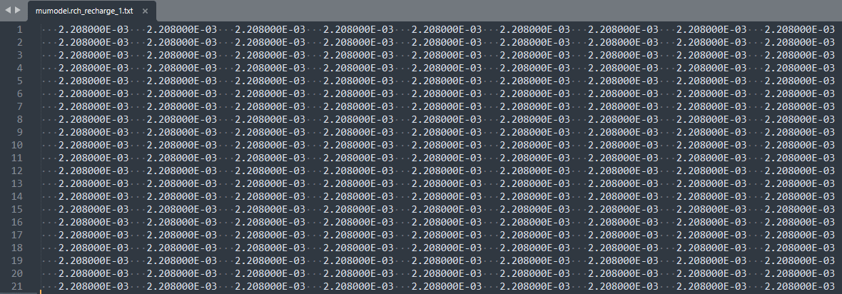
MODFLOW + Python = FLoPy model development
MODFLOW input is a collection of simple text files
Properties are defined as arrays or lists. In this case our model has a recharge rate defined for each model cell in the first stress period

Slide 14
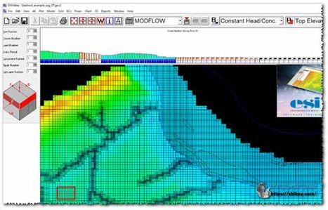
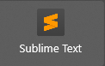
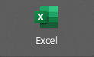
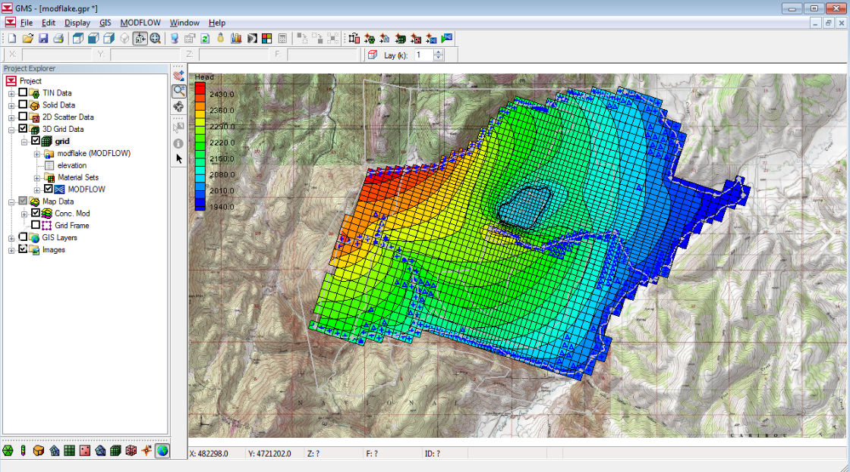
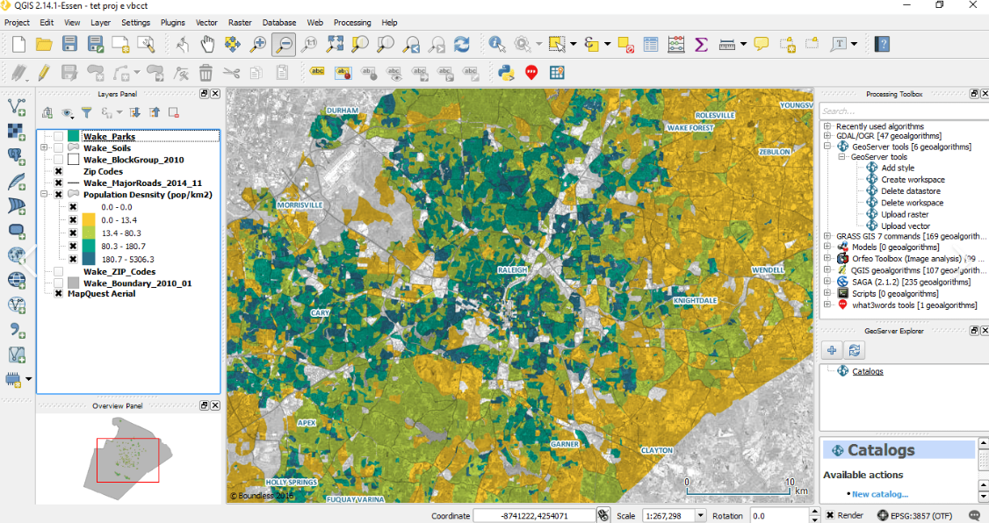
MODFLOW + Python = FLoPy model development
There are lots of ways to create model input!
GUIs, spreadsheet, straight up windows95 notepad
MODLOW doesn’t care how you create the text file, it just needs the values

Slide 15
MODFLOW + Python = FLoPy model development
In FloPY, we create python “objects” to represent our model and packages, and use “pythonic representations of data” to populate the package properties
=
np.ones((21,9)) * 0.002208

Slide 16
MODFLOW + Python = FLoPy model development
In FloPY, we create python “objects” to represent our model and packages, and use “pythonic representations of data” to populate the package properties
tpl_dir = os.path.join("data", "mumodel_tpl")
name = "mumodel“
exe_name = "mf6“
sim = flopy.mf6.MFSimulation.load(sim_ws=tpl_dir)
m = sim.get_model(name)
rch = m.rch
rch.recharge.set_data({0: 0.002208})

Slide 17
MODFLOW + Python = FLoPy model development
CONS:
Difficult (at first!)
Opaque (when creating)
PROS:
Fast (eventually!)
Flexible
Reproducible
Automatable
Free
Transparent (when reviewing)

Slide 18
MODFLOW + Python = FLoPy model development
DEMONSTRATION

Slide 19

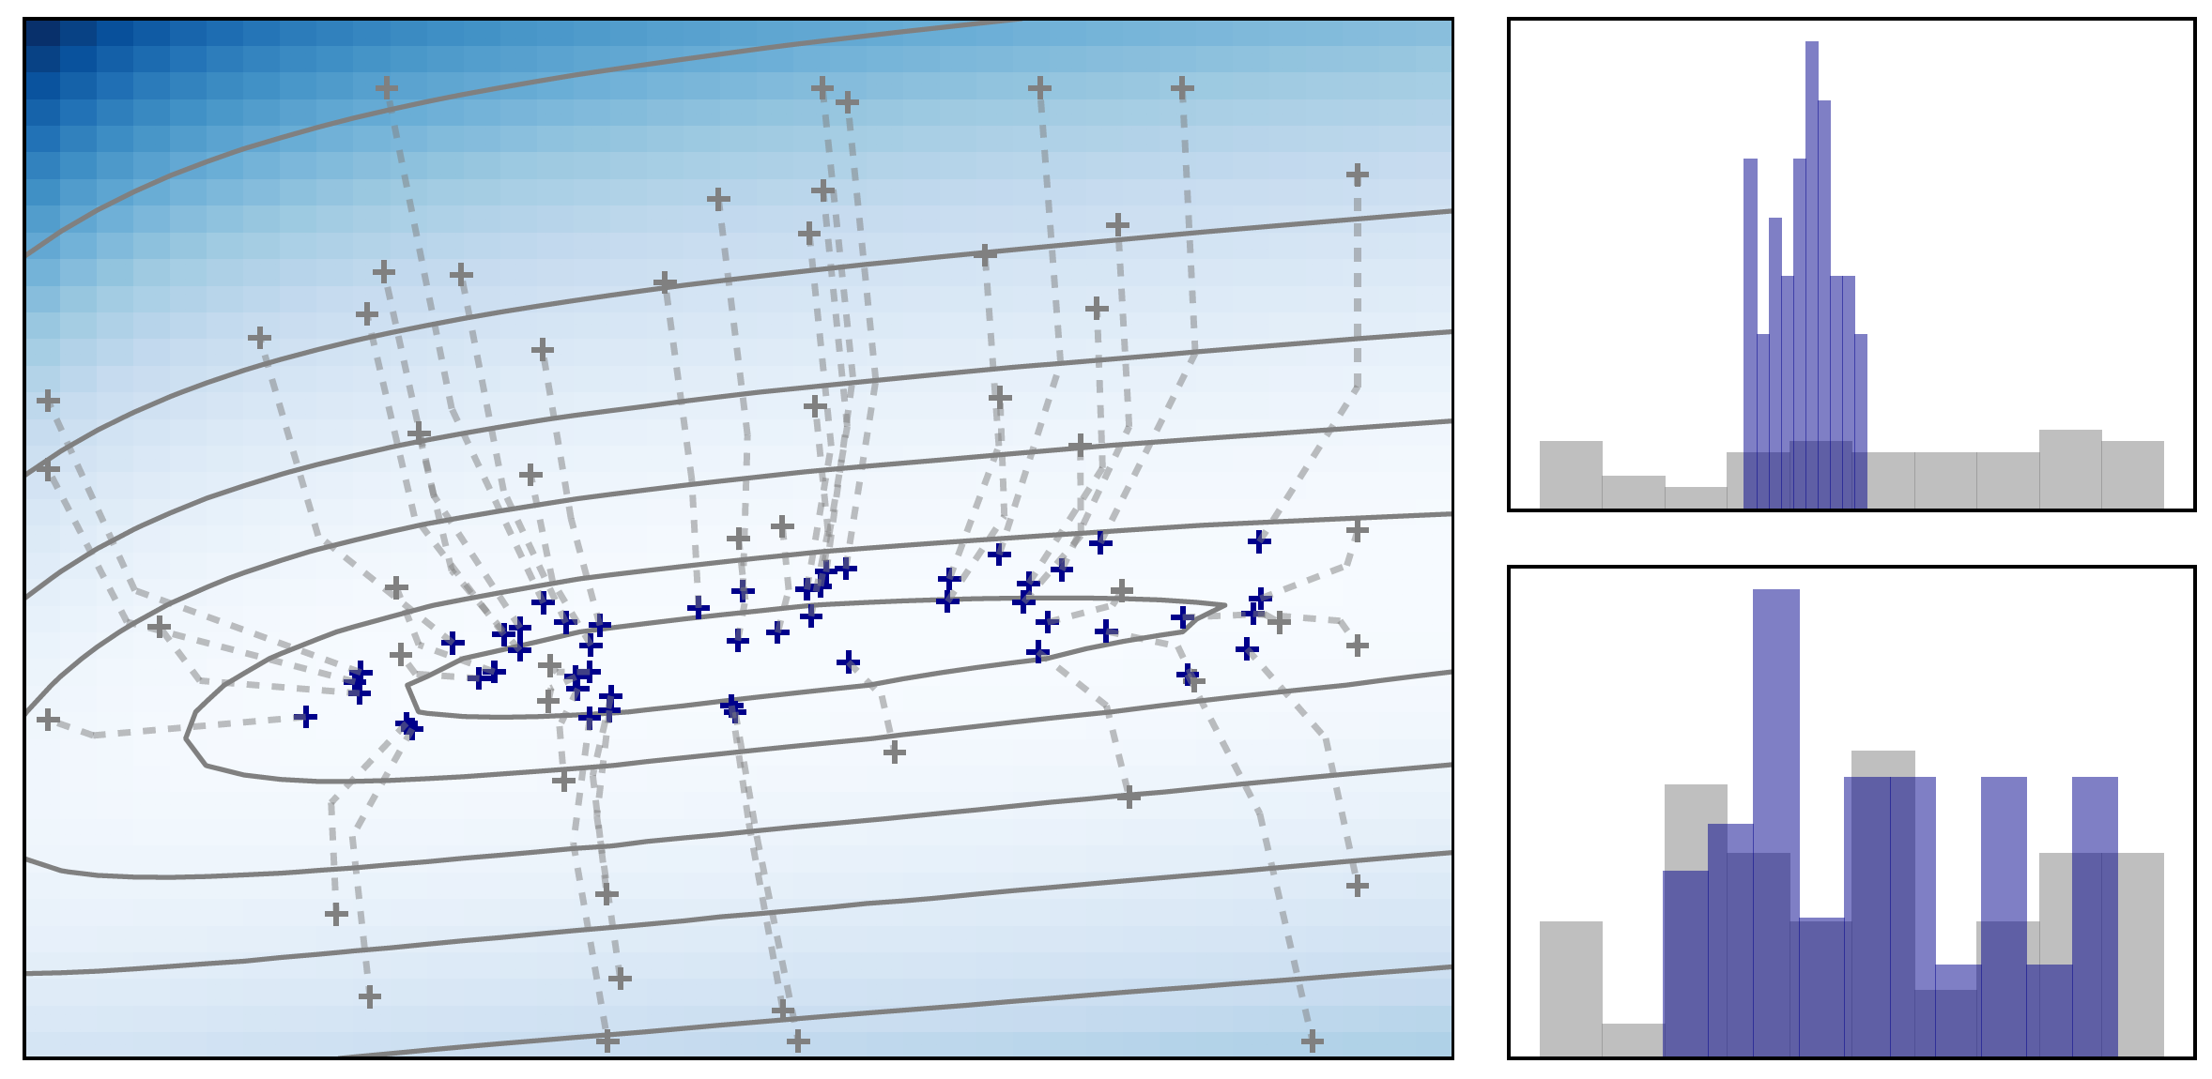
Part 2: PEST⁺⁺ + Python = PyEmu

Slide 20
PEST⁺⁺ + Python = PyEmu model deployment
PEST++ is a remake of PEST, written in C++ instead of (fortran?)
Free, Open Source, Incredibly Powerful
Requires a collection of input files that specify model inputs you want to adjust, and model outputs you want to track

Slide 21
PEST⁺⁺ + Python = PyEmu model deployment
In PyEmu we build a pest++ deployment for our model, using python “objects” to populate our pars, obs, and (many, many) settings.
Way too much to get into today
Quick demo of a simple model
Links to resources, examples

Slide 22
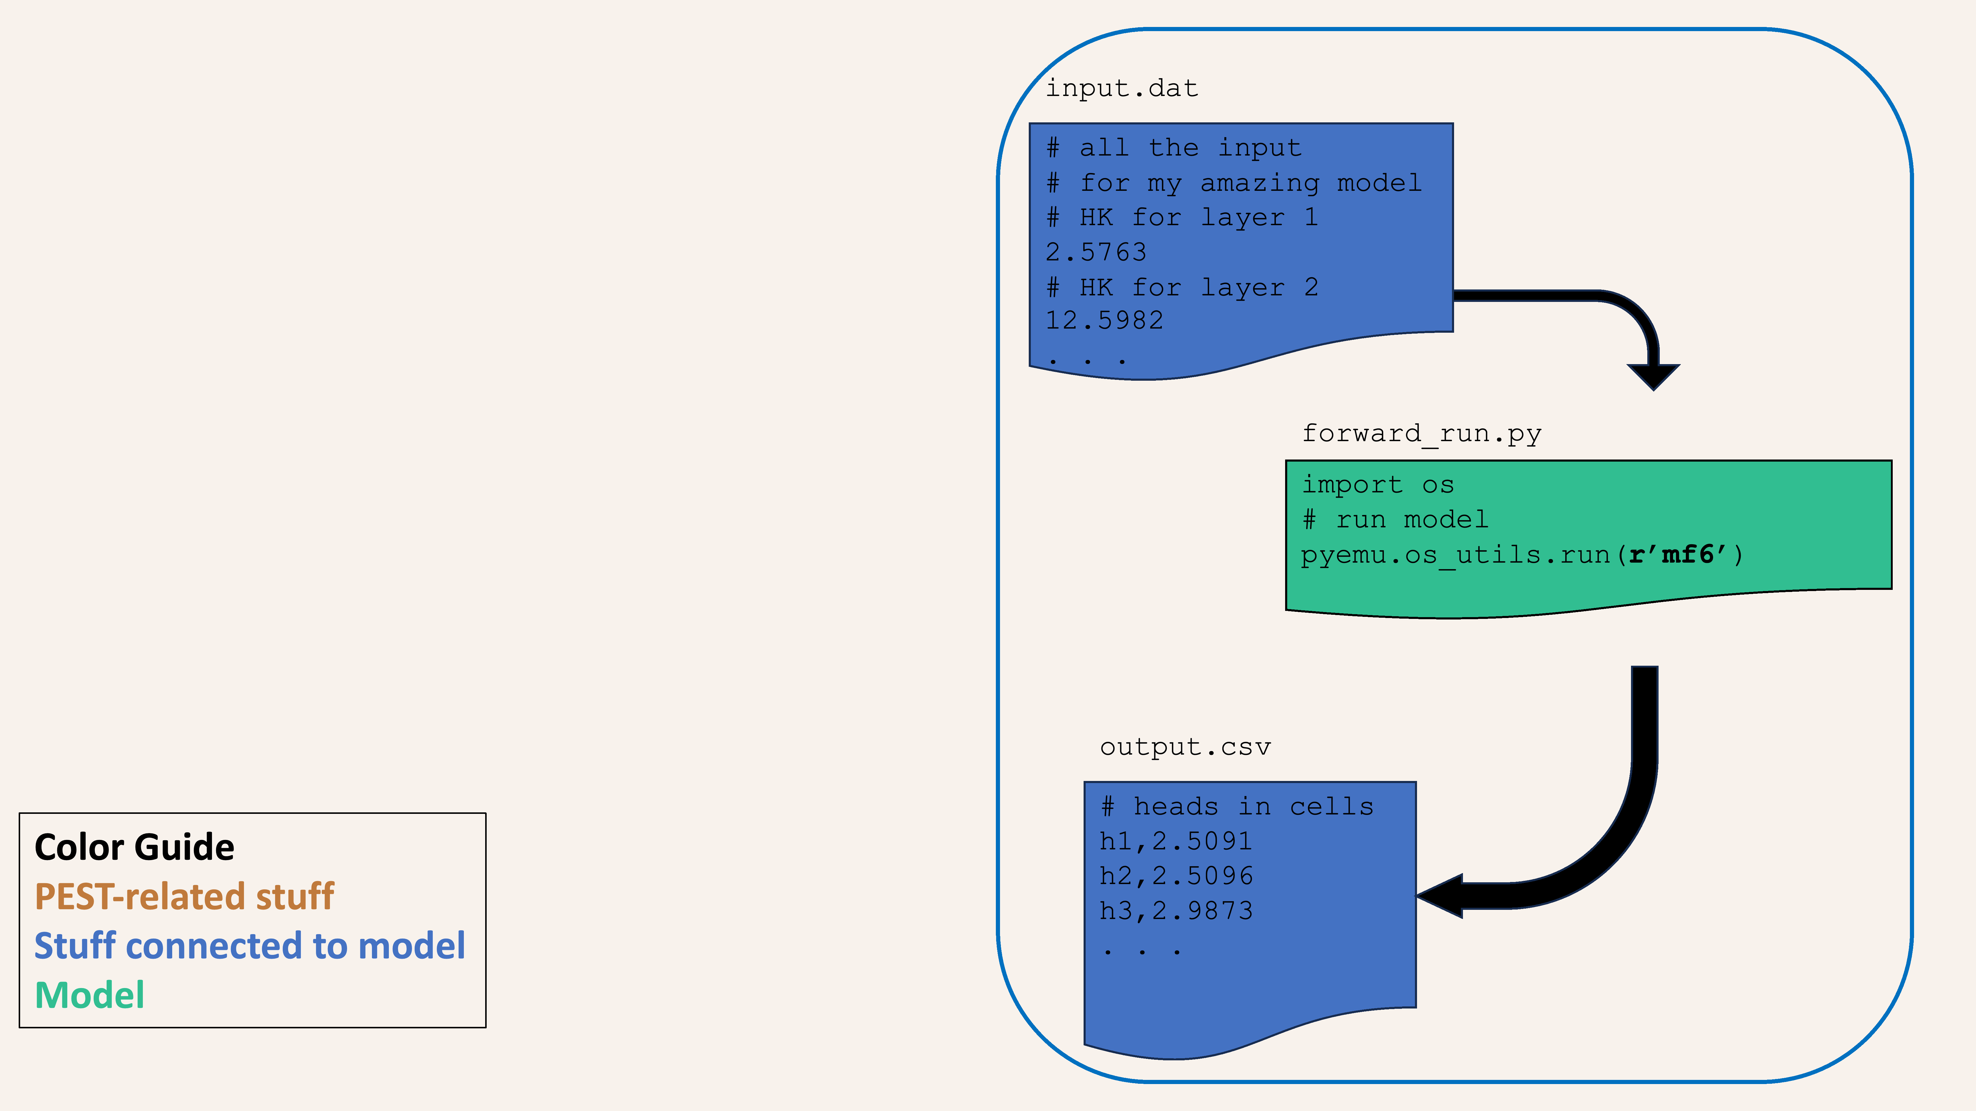

Slide 23
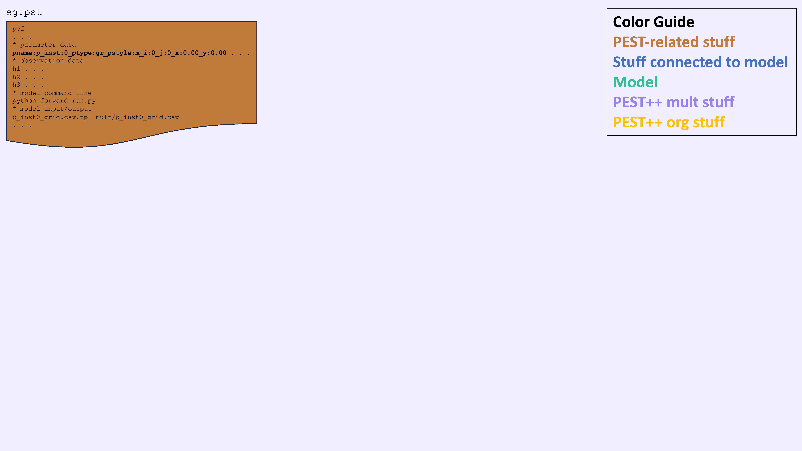

Slide 24
PEST++ (plus) Python = PyEmu model deployment
DEMONSTRATION

Slide 25


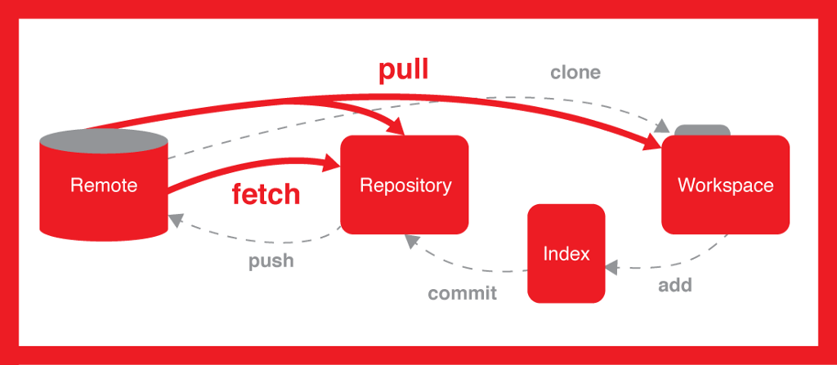

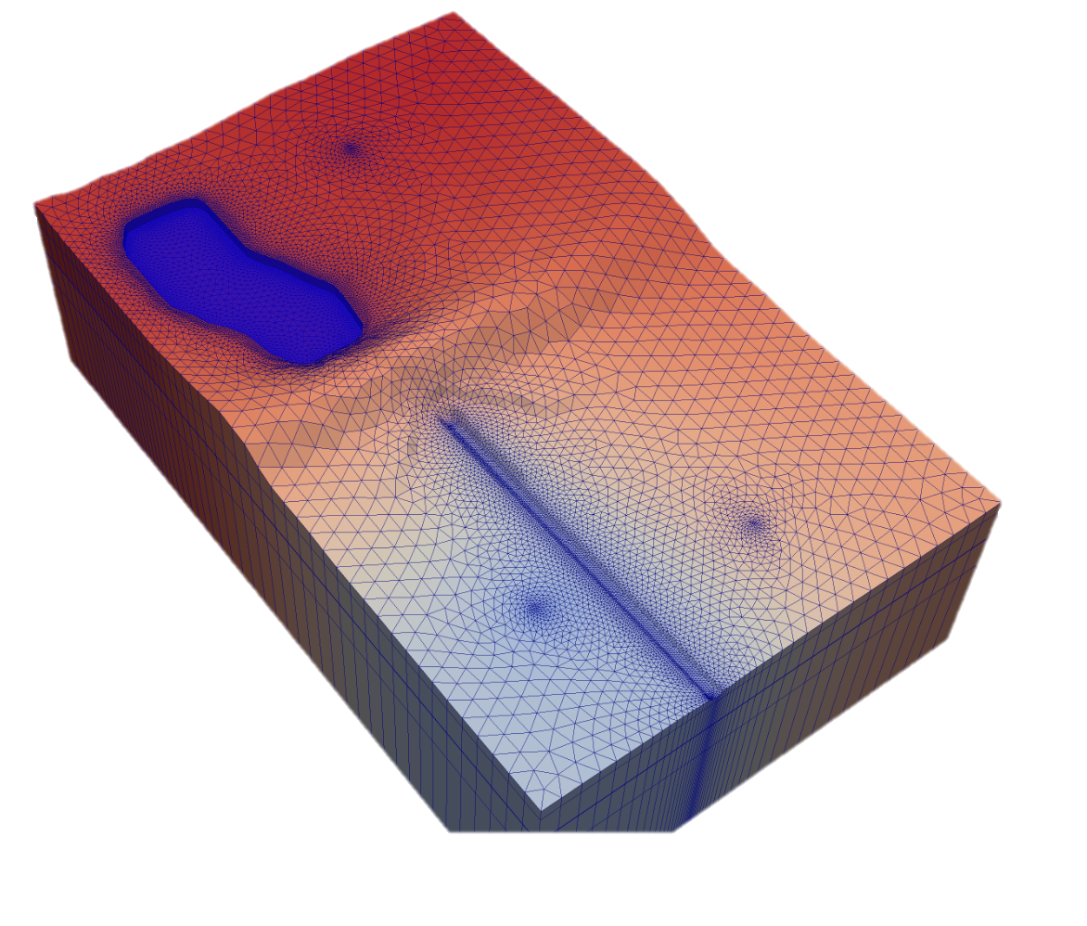
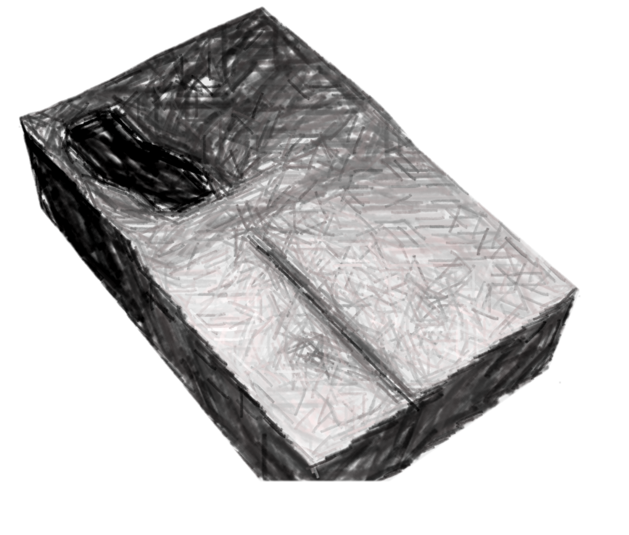
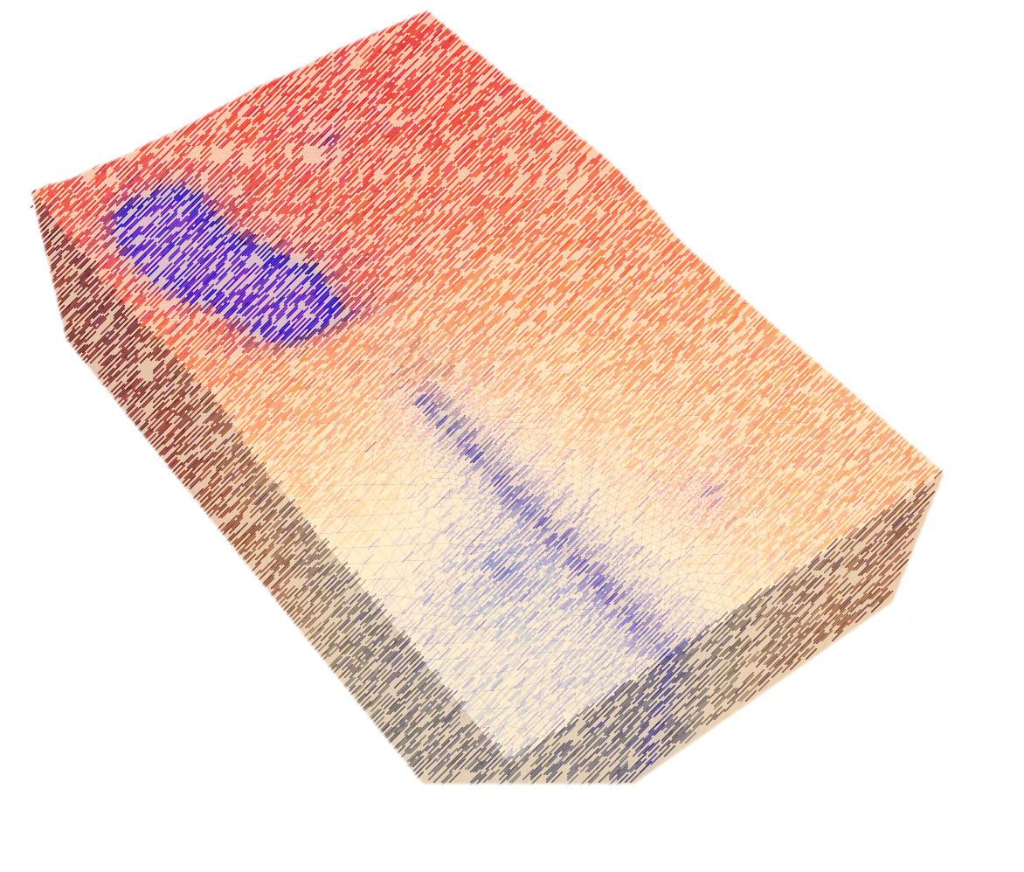
Part 3: Git + Python = my model development workflow

Slide 26
Supplemental Materials: How & where to get started
Python:
Free Download | Anaconda
Managing environments — conda 24.3.1.dev32 documentation
Git:
Git - Downloads (git-scm.com)

Slide 27
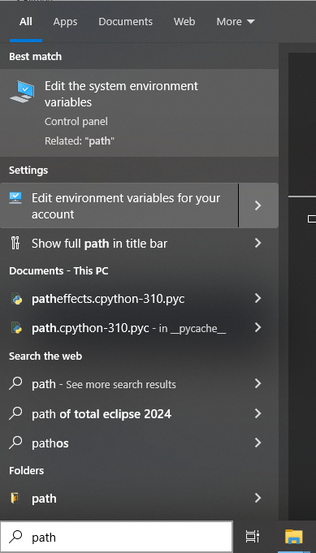
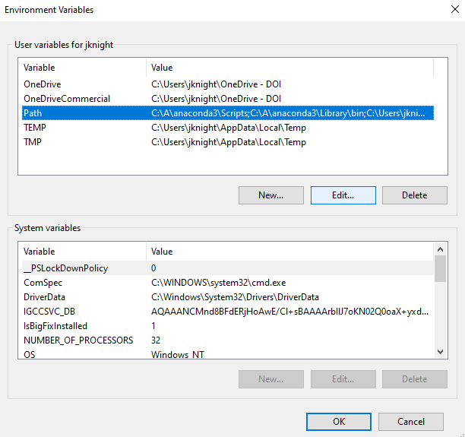
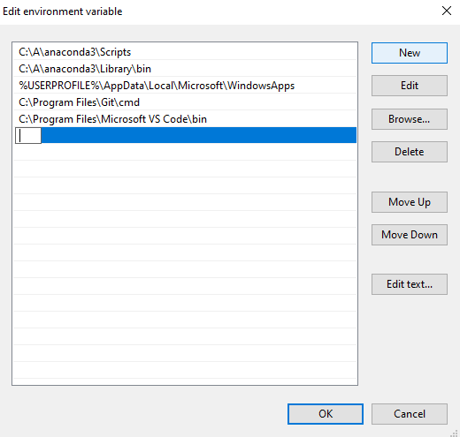
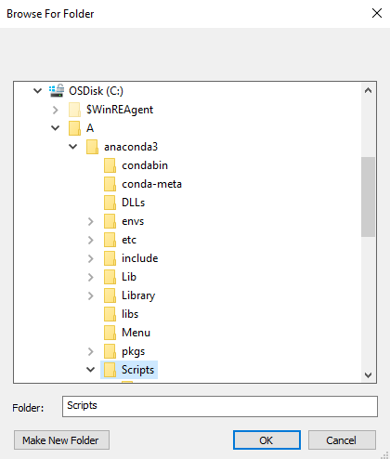
Supplemental Materials: How & where to get started
Edit environment variables FOR YOUR ACCOUNT (not system)

Slide 28
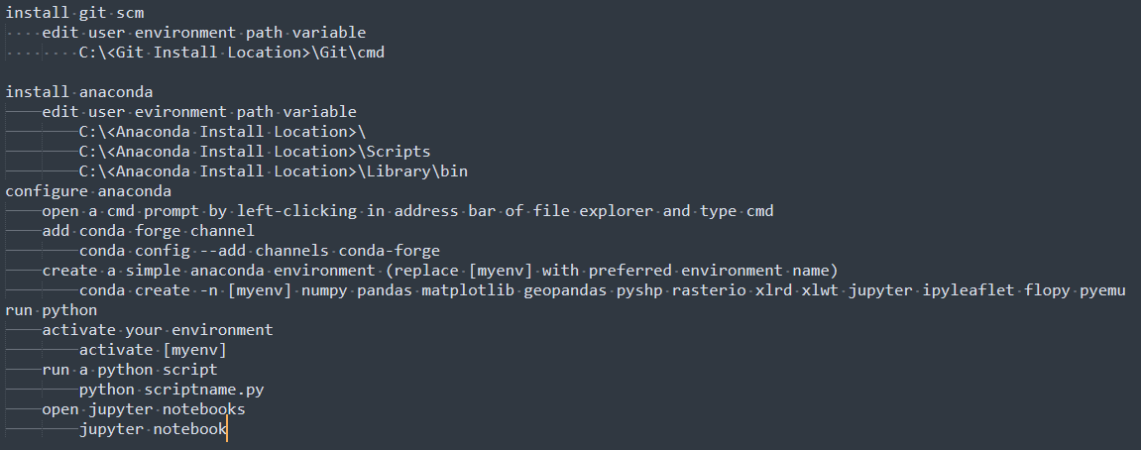
Supplemental Materials: How & where to get started
Edit environment variables FOR YOUR ACCOUNT (not system)

Slide 29
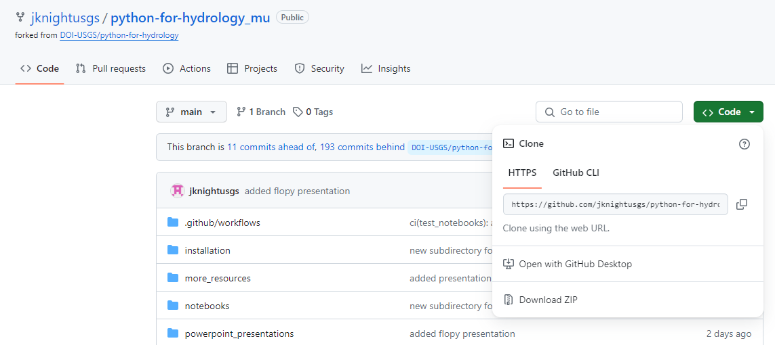
Supplemental Materials: How & where to get started
Today’s materials:
GitHub - jknightusgs/python-for-hydrology_mu: python and flopy tutorials for hydrologic applications and MODFLOW modeling
Download a static copy of the data and script used today

Slide 30
MODFLOW / FloPy Links
Releases · MODFLOW-USGS/modflow6 · GitHub
GitHub - MODFLOW-USGS/modflow6-examples: Collection of MODFLOW 6 example models
GitHub - modflowpy/flopy: A Python package to create, run, and post-process MODFLOW-based models.
Examples gallery — FloPy 3.7.0.dev0 documentation

Slide 31
PEST⁺⁺ / PyEmu Links
Release 5.2.7 · usgs/pestpp · GitHub
Approaches to Highly Parameterized Inversion: PEST++ Version 5, a Software Suite for Parameter Estimation, Uncertainty Analysis, Management Optimization and Sensitivity Analysis (usgs.gov)
pestpp/benchmarks/mf6_freyberg at master · usgs/pestpp · GitHub
GitHub - pypest/pyemu: python modules for model-independent uncertainty analyses, data-worth analyses, and interfacing with PEST(++)
GitHub - mnfienen/GW1876: Applied Groundwater Model Calibration and Uncertainty Analysis Class

